Slide 1
1st Lesson on Epidemiology

Slide 2
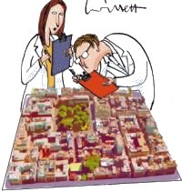
Epidemiology
The study of the distribution and determinants of health-related states or events in specified populations and the application of this study to the control of health problems

Slide 3

Frequency
Not only to number of health events such as the number of cases of meningitis or diabetes in a population, but also to the relationship of that number to the size of the population. The resulting rate allows epidemiologists to compare disease occurrence across different populations

Slide 4
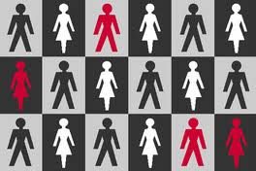
Pattern
Occurrence of health-related events by time, place and person. Time patterns may be annual, seasonal, weekly, daily, hourly, weekday versus weekend, or any other breakdown of time that may influence disease or injury occurrence. Place patterns include geographic variation, urban/rural differences, and location of work sites or schools. Personal characteristics include demographic factors which may be related to risk of illness, socioeconomic stats, as well as behaviors and environmental exposures

Slide 5
Determinants
Any factor, whether event, characteristic or other definable entity, that brings about a change in a health condition or other defined characteristic
ASSUME illness does not occur randomly in a population but happens only when the right accumulation of risk factors or determinants exists in an individual

Slide 6
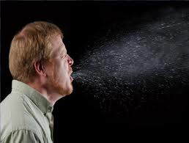
Communicable vs Non Communicable
Communicable – Able to be transmitted from one sufferer to another
Non-communicable – Not able to be transmitted from one person to another

Slide 7
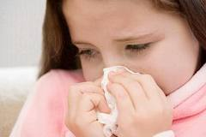
Communicable
Dengue Fever - also known as breakbone fever, is an infectious tropical disease caused by the dengue virus
Leprosy - a chronic bacterial disease of the skin and nerves in the hands and feet and, in some cases, the lining of the nose. Leprosy is a rare disease in the United States.

Slide 8
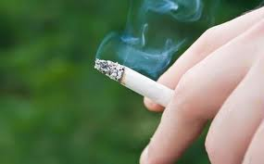
Non Communicable
Down Syndrome - also known as trisomy 21, is a chromosomal condition caused by the presence of all or part of a third copy of chromosome 21
Skin Cancer
Diabetes -is a metabolic disorder that is characterized by high blood glucose in the context of insulin resistance and relative insulin deficiency

Slide 9
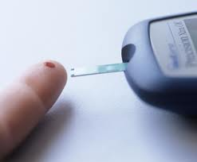
Chronic diseases
Long duration and generally slow progression
Examples:
Heart disease
Stroke
Cancer
Diabetes

Slide 10

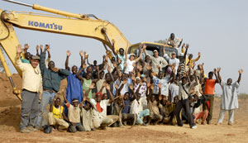
“Patient”
Epidemiologist consider their patients to be the whole community
Doctors treat individuals as patients
Notes:
Stopped here

Slide 11
History of Epidemiology
Classic case of John Snow
Read hand out

Slide 12
Assessing community health
Person
Place
time

Slide 13
Epidemiologic Functions
Public health surveillance
Field investigation
Analytic Studies
Evaluation
Linkages
Policy development

Slide 14
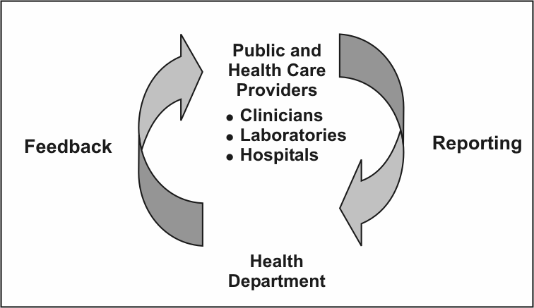
Public health surveillance
Information for Action

Slide 15
Field Investigation
Shoe leather epidemiology
Investigation by the public health department
Objectives
Lead to identification of unreported or unrecognized ill persons
Identity source or vehicle of infection that can be controlled or eliminated
Learn more about the natural history and risk factors of the disease

Slide 16
Analytic Studies
Evaluating the credibility of those hypotheses
Design
Determine appropriate research strategy and study design
Conduct
Securing appropriate clearances and approvals, tracking down and interviewing subjects
Analysis
Describing the characteristics of the subjects
Interpretation
Putting the study findings into perspective

Slide 17

Evaluation
Process of determining as systematically and objectively as possible, the relevance, effectiveness, efficiency and impact of activities with respect to established goals

Slide 18
Effectiveness and Efficiency
Effectiveness
Ability of a program to produce the intended or expected results in the field
Efficiency
Refers to the ability of the program to produce the intended results with a minimum expenditure of time and resources

Slide 19

Linkages
Maintain relationships with staff of other agencies and institutions

Slide 20
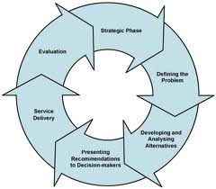
Policy development
Application of this study to the control of health problems

Slide 21
The Epidemiologic Approach
Counts
Cases of health events, and describes them in terms of time, place and person
Divides
The number of cases by an appropriate denominator to calculate rates
Compares
These rates over time or for different groups of people

Slide 22
Defining a Case
Set of standard criteria for classifying whether a person has a particular disease, syndrome, or other health condition

Slide 23
Components of a case definition
Clinical criteria
Laboratory tests
Symptoms
Signs
Time
Place
Person

Slide 24
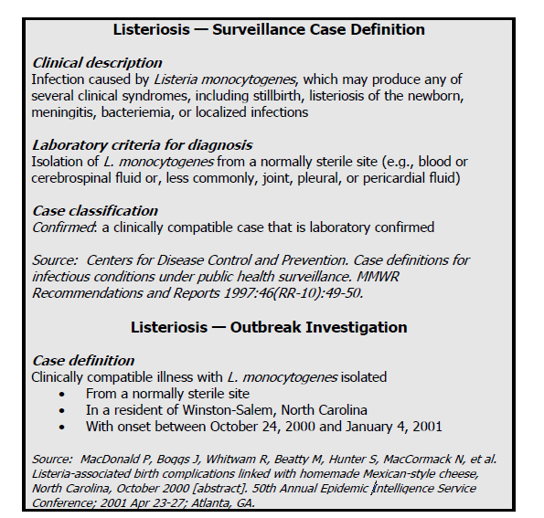

Slide 25
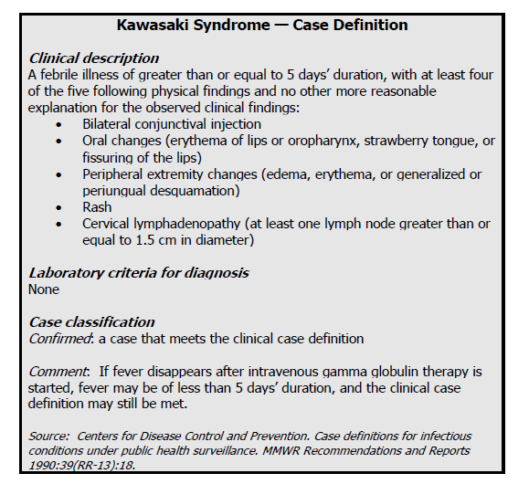
Notes:
Childhood illness with fever and rash that has no known cause and no specifically distinctive laboratory findings

Slide 26
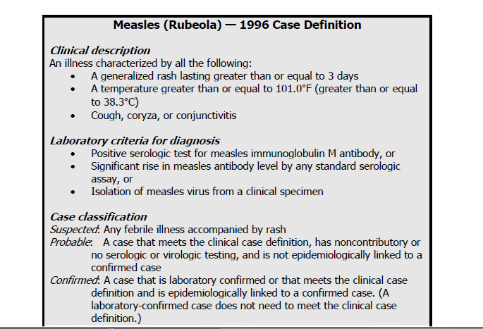
Criteria in case definitions
Suspected or probable
Waiting for laboratory results

Slide 27
Counts and Rates
Counts valuable for health planning
Doses of vaccine
Rates
Measures that relate the numbers of cases during a certain period of time to the size of population
Useful for comparing the frequency of disease in different locations whose populations differ in size or during different periods of time

Slide 28
5W’s of descriptive epidemiology
What = health issue of concern
Who = person
Where = place
When = time
Why/How = causes, risk factors, modes of transmission

Slide 29
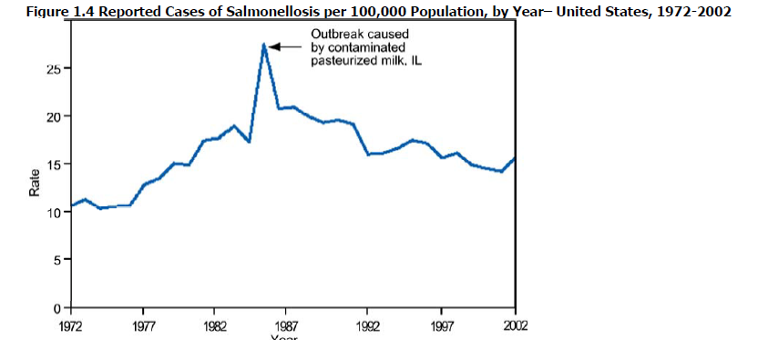
Time
Occurrence of disease changes over time

Slide 30
Secular vs Seasonality
Secular = graphing annual cases or rate of disease over a period of years
Seasonality = graphed by week or month over the course of a year
Also graphed by week and time of day

Slide 31
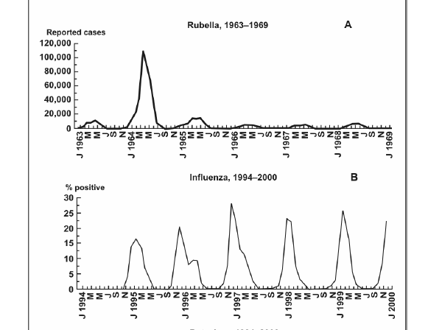
Seasonal Patterns

Slide 32
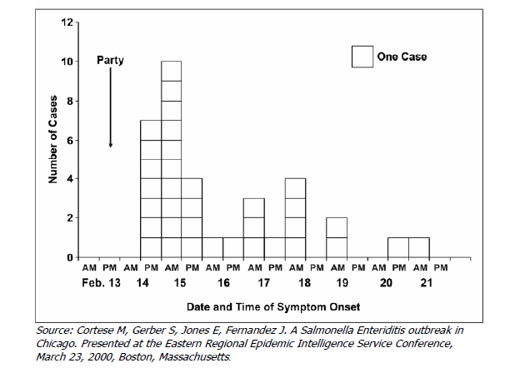
Epidemic Period
Epidemic curve (show time course of a disease outbreak)
Displayed as histograms

Slide 33
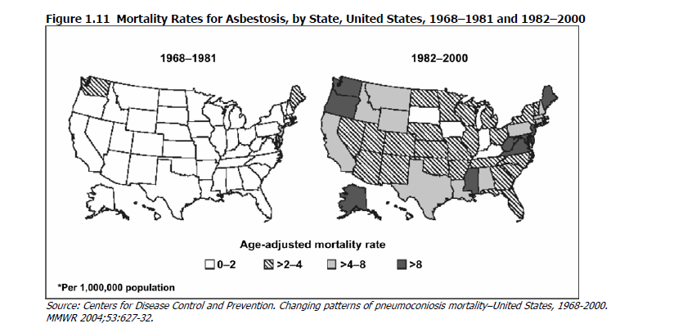
Place
Geographic extent of the problem and its geographic variation

Slide 34
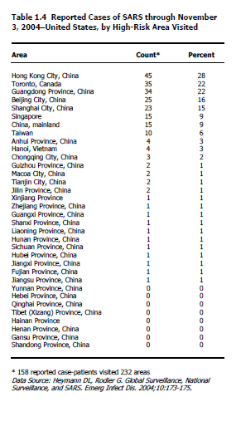

Slide 35
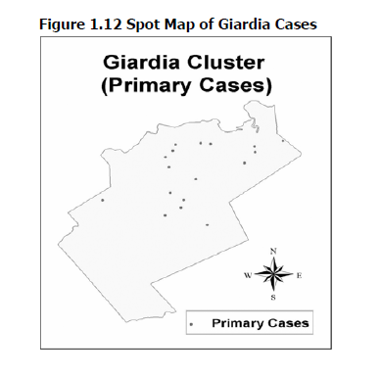
Cluster Map

Slide 36
Person
Age
Sex
Race
Biologic characteristics
Acquired characteristics
Activites
Conditions

Slide 37
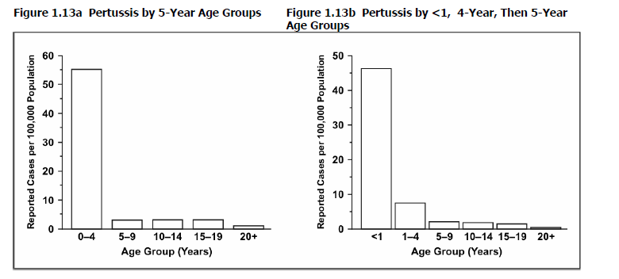
Age
Most important “person” attribute

Slide 38
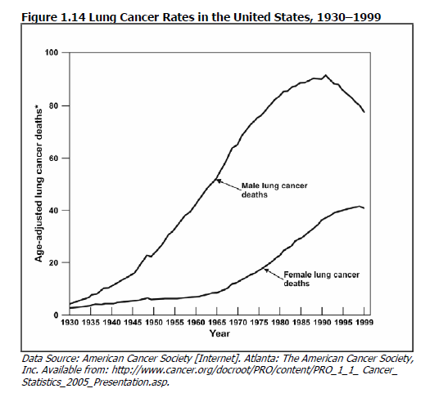
Sex
Female vs Males

Slide 39
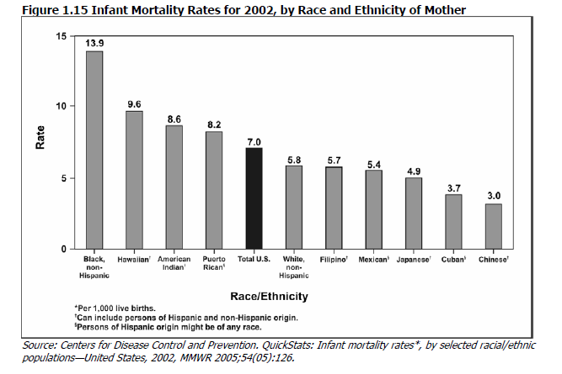
Ethnic and Racial Group

Slide 40
Socioeconomic Status
Difficult to quantify
Many adverse health conditions increases with decreasing socioeconomic status

